Slide 1

Business Intelligence & Business Analytics BIBA
Topic 1
Intelligent Enterprises

Slide 2
Introduction
Sean Heeney
Bsc Computer Science , IT Management , Tallaght IT
H.Dip AML (Uni Manchester)
H.Dip Computer Science (NCIRL)
Msc Cloud Computing (NCIRL)
PayPal / Ebay Inc : Risk & Finance IT (FinTec)
SAP : Cloud Integrations
Lecturing in SOC In DA / CC / FinTec / Cyber
Email: sean.heeney@ncirl.ie

Slide 3
Early Morning Quiz
The science of examining raw data with the purpose of drawing conclusions about that information.
Data Analytics
In-memory Analytics
Descriptive Analytics
Predictive Analytics

Slide 4
Early Morning Quiz
A voluminous amount of structured, semi-structured and unstructured data that has the potential to be mined for information.
Small Data
Meta Data
Statistical Data
Big Data

Slide 5
Early Morning Quiz
SAAS stands for?
System Aerosurface Actuator Simulation
Systems as a Service
Software acting as Service
Software as a Service

Slide 6
Early Morning Quiz
According to a study conducted by IBM, what is the largest single source where data is gathered?
Email
Social Media
Business Transactions
Log Data

Slide 7
Early Morning Quiz
What is the name of the programming framework originally developed by Google that supports the development of applications for processing large data sets in a distributed computing environment?
Hive
Zookeeper
Hadoop
MapReduce

Slide 8
Early Morning Quiz
An approach to querying data when it resides in a computer's random access memory (RAM), as opposed to querying data that is stored on physical disks.
Deep Analytics
Data Visualisation
In-memory Analytics
Data Analytics

Slide 9
Early Morning Quiz
Leading analyst firm Gartner defines Big Data from three aspects, all starting with the letter V. Which of these are not a part of their consideration of big data?
Value
Volume
Variety
Velocity

Slide 10
Early Morning Quiz
A method of storing data within a system that facilitates the collocation of data in various schemata and structural forms
Data Visualisation
Data Lake
Big Data Management
Deep Analytics

Slide 11
Early Morning Quiz
What 3 Countries have the highest GDP?
United States (GDP: 21.41 trillion)China (GDP: 15.54 trillion)Japan (GDP: 5.36 trillion
What is the largest Continent ?
Generally identified by convention rather than any strict criteria, up to seven regions are commonly regarded as continents. Ordered from largest in area to smallest, they are: Asia, Africa, North America, South America, Antarctica, Europe, and Australia.

Slide 12
Early Morning Quiz
Name Five Countries Ending in the Letter ‘L’

Slide 13
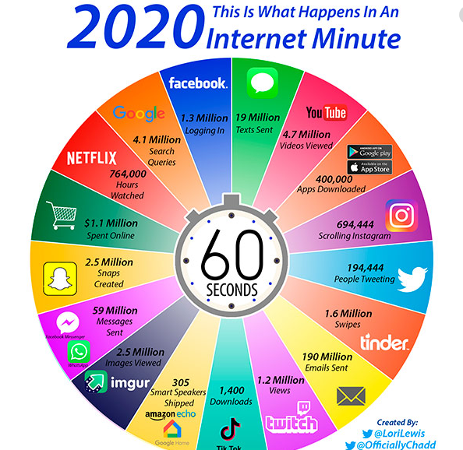
In The Last Minute

Slide 14
Assessment Strategy
CA 1 20%
Short Questions– Assessing the theoretical aspects of our learning materials
CA2 80%
Analyze Requirements, Design and Implement an end-to-end BI and Analytics system for an organization.

Slide 15
Topic One: Intelligent Enterprises
Agile Enterprises
Operating Strategies
Continuous Improvement Programs - CIP

Slide 16
Key Terms
ERP: Enterprise Resource Planning
CRM: Customer Relationship Management
SCM: Supply Chain Management
PLM: Project Lifecycle Management
BPM: Business Process Management
BI: Business Intelligence

Slide 17










Prominent Providers
https://www.selecthub.com
All of the above companies have a strong presence in the Irish Market with many EU Headquarters in Ireland

Slide 18
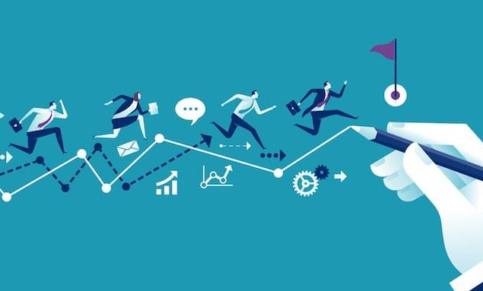
Demand for Agile Enterprise
The difficult challenges facing businesses today require enterprises to be transitioned into flexible, agile structures that can respond to new market opportunities quickly with a minimum of new investment and risk.
There is an established need to be simultaneously efficient, flexible,
responsive, and adaptive

Slide 19

Demand for Agile Enterprise
In Order to achieve this, Organizations have had to evolve the very structure of the Organization itself.
An evolution into Agile Enterprises with :
Relatively Small
Autonomous teams
With the ability to work concurrently
Reconfiguring quickly
Adopting highly decentralized management that recognizes its knowledge base and manages it effectively.

Slide 20
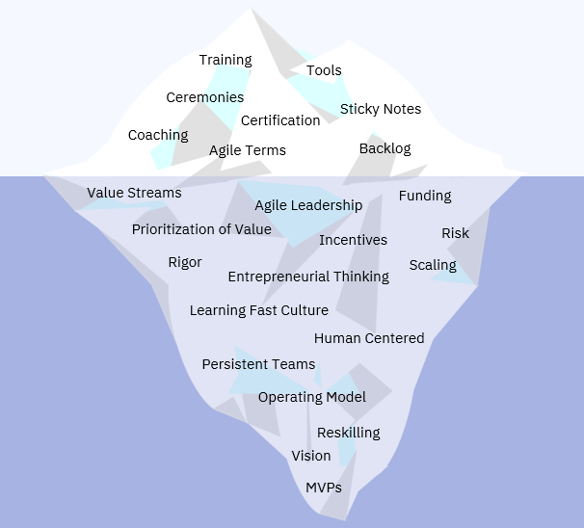
The Age of Enterprise Agility
Internet Iceberg
https://www.linkedin.com/pulse/age-enterprise-agility-florian-schmidt
Notes:
https://miro.medium.com/max/9455/1*cr-gQUcV5TQLU83ZWdNVPA.jpeg

Slide 21
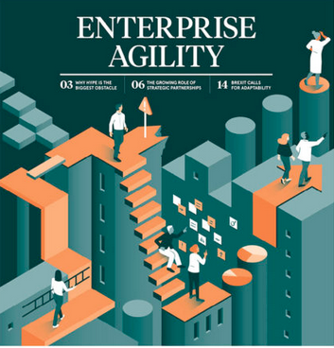
What Defines Enterprise Agility ?
There are 2 well established factors
which define enterprise agility
Responsiveness
To be intelligence intensive
Within these 2 factors we have the
following subsections
https://www.raconteur.net/business-innovation/cio-enterprise-agility

Slide 22
Responsiveness
Adaptability is enabled by the concept of loosely coupled interacting components reconfigurable within a unified framework.
This is essential for ensuring opportunity management to sustain viability.

Slide 23
Responsiveness
The ability to be responsive involves the following aspects:
An organizational structure that enables change
Based on reusable elements that are reconfigurable in a scalable framework.
Reusability and re-configurability are generic concepts that are applicable to work procedures, manufacturing cells, production teams, or information automation systems.
Additionally and Equally Important:
An organizational culture that facilitates change and focuses on change proficiency
(More on Change Management in Coming Weeks)

Slide 24
Intelligence Intensive
The ability to be intelligence intensive or to manage and apply knowledge effectively whether it is knowledge of a customer, a market opportunity, a competitor’s threat, a production process, a business practice, a product technology, or an individual’s competency.
This is essential for ensuring innovation management to sustain leadership.

Slide 25
Intelligence Intensive
The ability to be intelligence intensive involves the following aspects:
• Enterprise knowledge management (KBA / Best Practices) <- More on this in BI and DW
• Enterprise collaborative learning (Knowledge Sharing)

Slide 26
Enterprise Agility
When confronted with a competitive opportunity a smaller company is able to act quickly, whereas a larger company has access to more comprehensive knowledge (options, resources, etc.) and can decide to act sooner and more thoroughly.

Slide 27
Agility
Agility is the ability to respond to (and ideally benefit from) unexpected change.
Agility is unplanned and unscheduled adaption to unforeseen and unexpected external circumstances.

Slide 28
Agility
One of the foremost abilities of an agile enterprise is its ability to quickly react to change and adapt to new opportunities.
This ability to change works along two dimensions:
The number or “types of change” an enterprise is able to undergo (Range)
The “degree of change” an enterprise is able to undergo (Response Ability)

Slide 29
Enterprise Agility Framework
Enterprises primarily aim progressively for efficiency, flexibility, and innovation in that order.
The Model Builder, Erector set, and LEGO kits are illustrations of enterprises targeting for efficiency, flexibility, and innovation (i.e., agility), respectively.

Slide 30
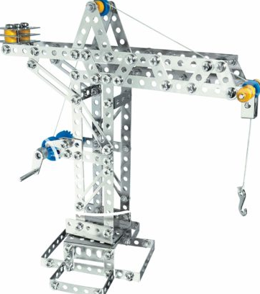
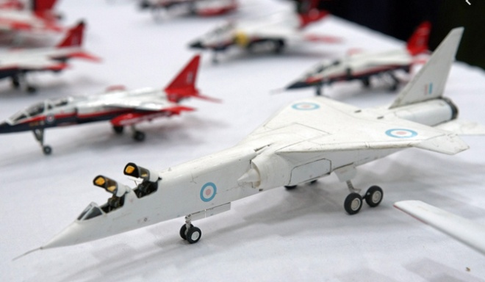
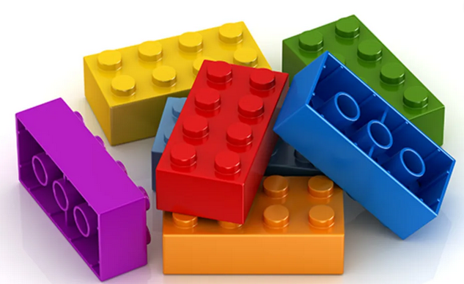
Enterprise Agility Framework
Construction toys offer a useful metaphor because the enterprise systems we are concerned with must be configured and reconfigured constantly.. precisely the objective of most construction toys.

Slide 31
Enterprise Agility Framework
You can build virtually anything over and over again with any of these toys;
But fundamental differences in their architecture give each system unique dynamic characteristics.

Slide 32


Enterprise Agility Framework
Model Kit, built once, looks good, but finite and static.
We attach one part to another—a nut-and-bolt pair and a 90-degree elbow. The components in the system all have holes through which the bolts may pass to connect one component with another. When a nut is lost, a bolt is useless, and vice versa;
When all the nuts and bolts remaining in a
set have been used, any remaining construction
components are useless, and vice versa

Slide 33
Enterprise Agility Framework
The Model Builder’s kit has a tight framework: A precise construction sequence, no part interchangeability, and high integration.
Erector Set has a loose framework that does not encourage interaction among parts and insufficiently discriminates among compatible parts.
In contrast, each component in the LEGO system carries all it needs to interact with other components
(the interaction framework rejects
most unintended parts), and it can
grow without end.

Slide 34


An Agile Enterprise
Agile companies produce the right product, at the right place, at the right time, at the right price for the right customer.
As pointed out by Jagdish Sheth in these times of market change and turbulence, the half-life (i.e., the time within which it loses currency by 50%) of customer knowledge is getting shorter and shorter.
https://en.wikipedia.org/wiki/Jagdish_Sheth

Slide 35
Operating Strategy
2 Differing approaches for running a business
Agile or Lean
Lean Production is simply an enhancement of mass production methods
Agility implies breaking out of the mass production mold and into mass
customization

Slide 36
Operating Strategy
Agile focuses on economies of scope rather than economies of scale.
Serving smaller niche markets , without the traditional increasing costs associated with customization
Agility is Enterprise Wide
Lean Production is more towards efficient
use of resources on the operations floor.
https://www.teamwork.com/project-management-guide/agile-project-management/

Slide 37
Enterprise-Wide Continuous Improvement Programs
Lean :
Excellent Operational System
Six Sigma:
Attaining Quality Improvement
Theory of Constraints:
Identify and removing bottlenecks
SCOR (Supply Chain Ops Reference Model)
Industry Wide Analytical Methodology

Slide 38
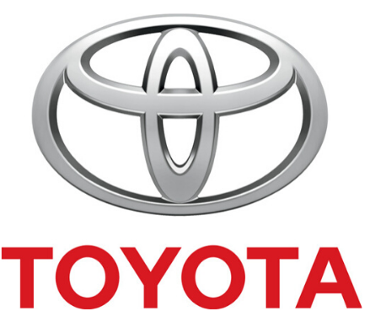
Enterprise-Wide Continuous Improvement Programs
Lean
Based on Toyota Production System (TPS)
Perfected over more than 50 Years
Inspired by Ford Motor Company
http://www.aleanjourney.com/2013/10/lean-quote-eiji-toyodas-respect-for.html

Slide 39
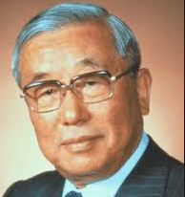

Enterprise-Wide Continuous Improvement Programs
Eiji Toyoda
"…employees are offering a very important part of their life to us. If we don’t use their time effectively, we are wasting their lives." — Eiji Toyoda, former President and Chairman of Toyota Motor Corporation
http://www.aleanjourney.com/2013/10/lean-quote-eiji-toyodas-respect-for.html

Slide 40
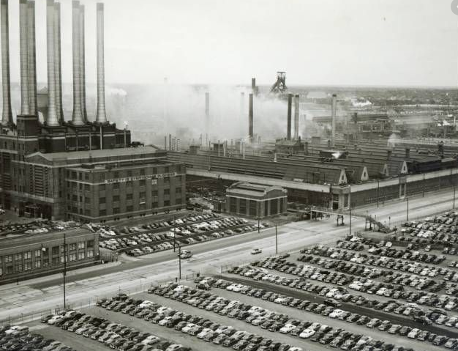
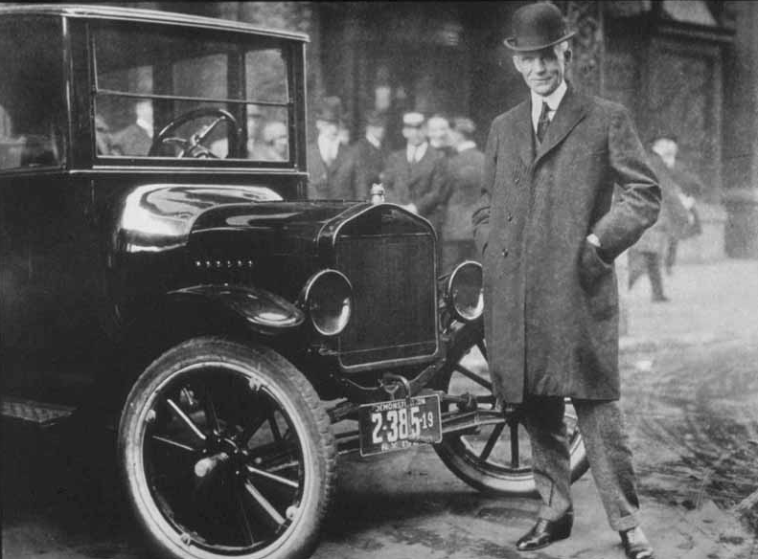
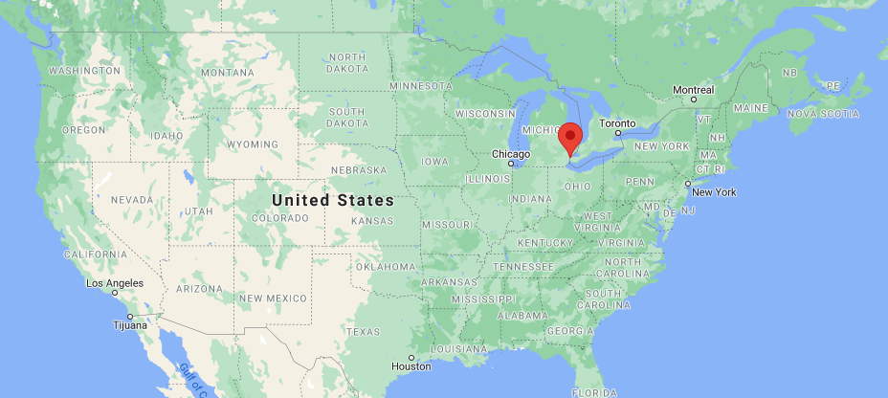
Enterprise-Wide Continuous Improvement Programs
In 1950 Toyota was in Turmoil
Eiji went to Detroit, Ford Motor Company to learn how to improve the family business.
He spent 3 months (A Semester) studying Ford’s manufacturing techniques
in detail.
While this mass production was
Right for 1913 it wasn’t suitable
for the demands of the 1950s
"You can have any colour as long as it is black".

Slide 41
Enterprise-Wide Continuous Improvement Programs
Toyota is now known as a powerhouse of manufacturing and production around the world.
This was achieved through Eiji’s efforts
What he established is considered as the central organizing concept of Toyota
A multi-product flow.
Different Models go down the same line without preventing the goals of minimal throughput time and inventory targets

Slide 42

Bibliography
These are the recommended Reading Materials if you would like to further your understanding.
Recommend: Vivek Kale, Enhancing Enterprise Intelligence: Leveraging ERP, CRM, SCM, PLM, BPM, and BI (CRC Press). 8 Currently Available in NCI Library
https://www.amazon.co.uk/Enhancing-Enterprise-Intelligence-Leveraging-ERP/dp/1498705979

Slide 43
Bibliography
Supplementary:
Can be reviewed on the module descriptor on the top of our moodle page for BIBA

